Slide 1



Microsoft Teams Meetup Berlin
1. Meetup | 2018-11-28
Notes:
Photo by rawpixel.com from Pexels

Slide 2

Thomas Stensitzki
Enterprise Consultant | Owner Granikos GmbH & Co. KG
MVP | Office Apps & Services
Thomas.Stensitzki@Granikos.eu Twitter: @Stensitzki
Blog DE: http://Blog.Granikos.eu
Blog EN: http://JustCantGetEnough.Granikos.eu

Slide 3
Teams Windows Desktop Client​
Q & A Microsoft Teams​
Organisatorisches

Slide 4
Teams Windows Desktop Client
→ Präsentation

Slide 5
Q & A Microsoft Teams
Einsatzmöglichkeiten
Skype for Business / Microsoft Teams
Yammer / Teams
Web- / Desktop-Client

Slide 6
Office 365 Roadmap
Success with Teams Practical Guidance
Coffee in the Cloud on YouTube
Microsoft Technical Community
All public feature delivery dates
Filter by product
Product forums and blogs
Driving Adoption forum
O365 Champion’s Corner
Diversity & Inclusion Forum
Learn how to plan, deliver, adopt and manage Microsoft Teams
Includes Skype for Business to Teams transition guidance
Short how-to videos for IT Pro’s and Champions
Long form end user & administrator training
https://aka.ms/O365Roadmap
https://aka.ms/TeamsCommunity
https://aka.ms/SuccessWithTeams
https://aka.ms/CoffeeintheCloud

Slide 7
Teams Dev Center
Success with Teams Developer Guidance
Developer Support
Announcements and program information
Stay up to date on best practices and network with peers
Learn how to plan, deliver, adopt and manage Microsoft Teams
Includes Skype for Business to Teams transition guidance
Use our resources to get up to speed quickly
Training and tutorials
Get started building great apps, bots & tabs for Microsoft Teams
https://aka.ms/TeamsDeveloper
https://aka.ms/TeamsDevSupport
https://aka.ms/TeamsDevDocs

Slide 8
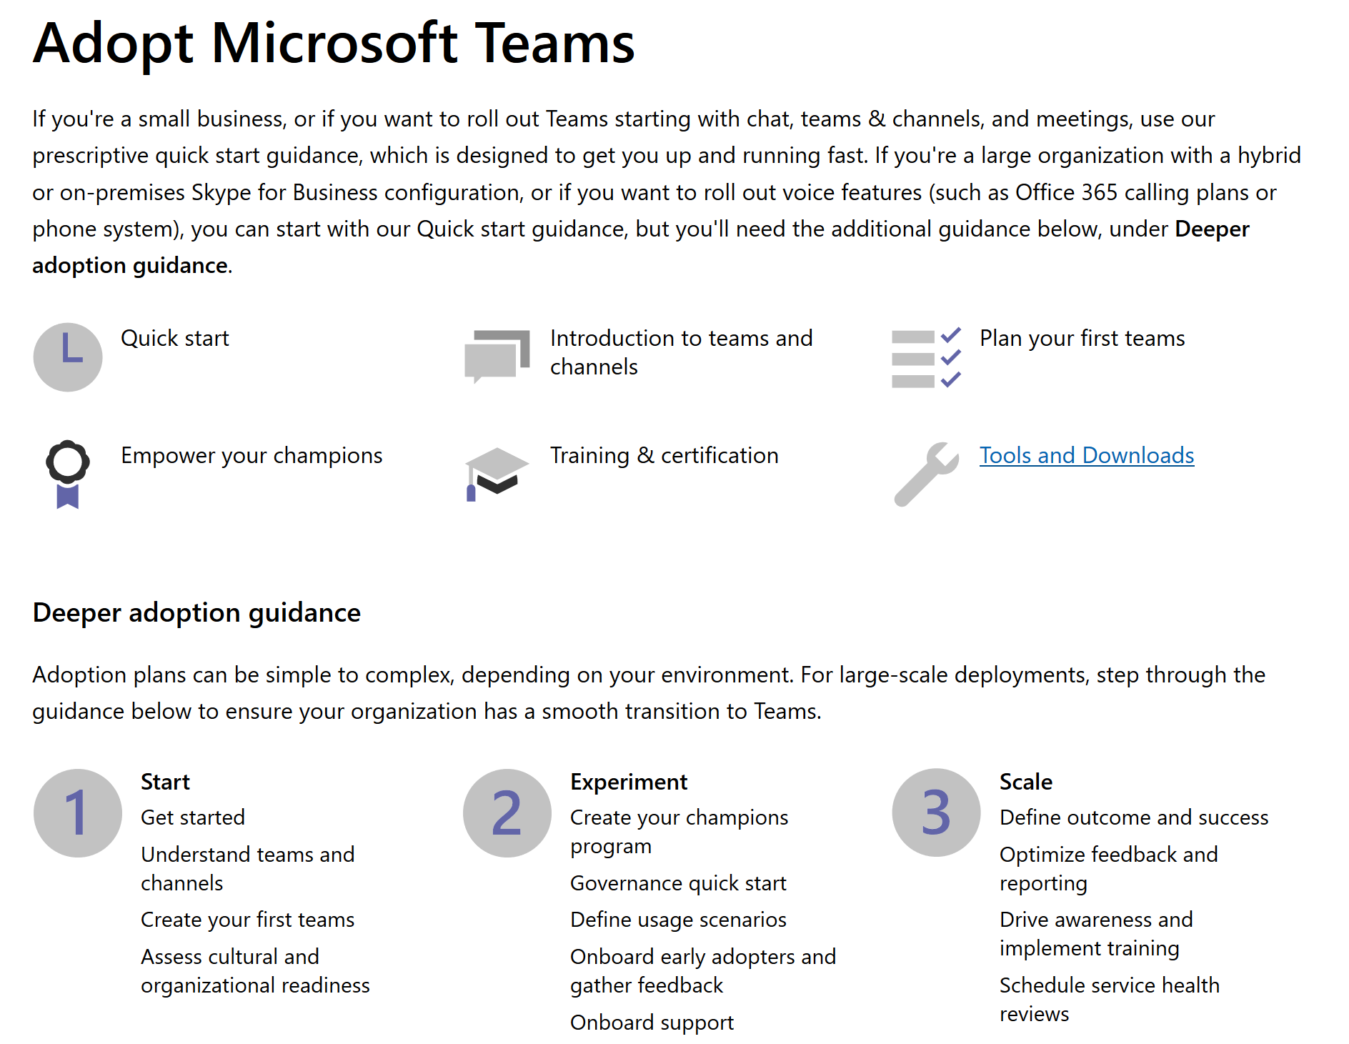
https://aka.ms/TeamsAdoption

Slide 9
Organisatorisches
Themen
Erfolgsgeschichten
Termine

Slide 10
Bis zum nächsten Meetup!

